Slide 1

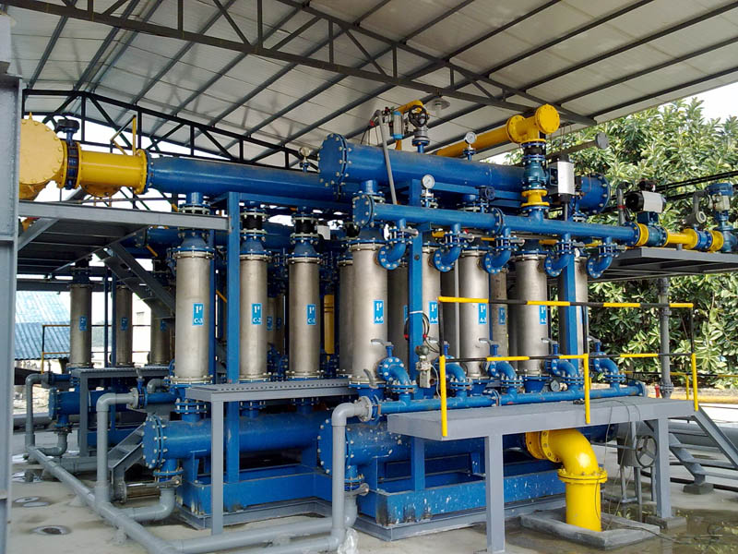
Ceramic Filter for Brine Filtration
Bluestar(Beijing) Chemical Machinery Co., Ltd

Slide 2

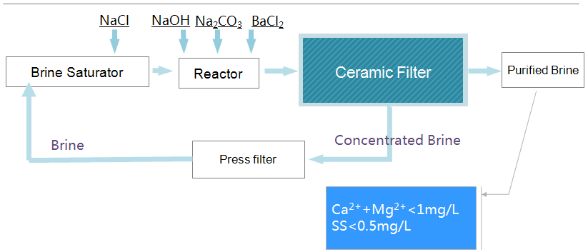
Brine Filtration Process
Salty Cake (CaCO3 &Mg(OH)2

Slide 3
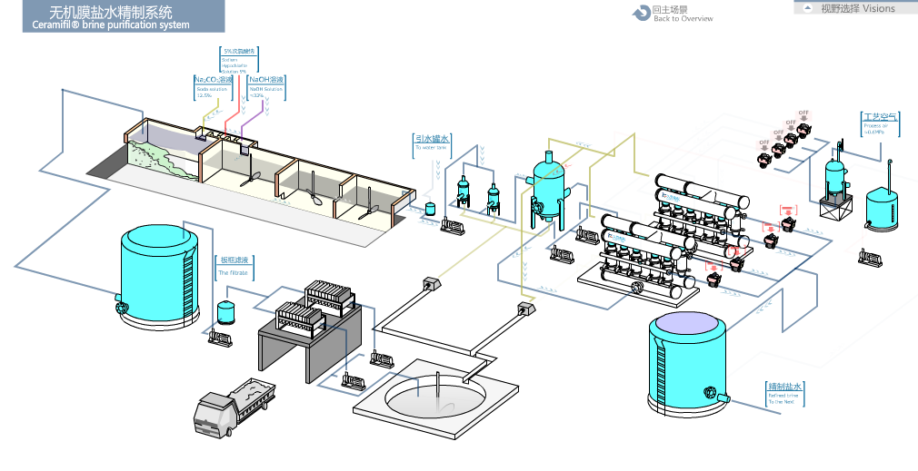
Brine Filtration Process

Slide 4
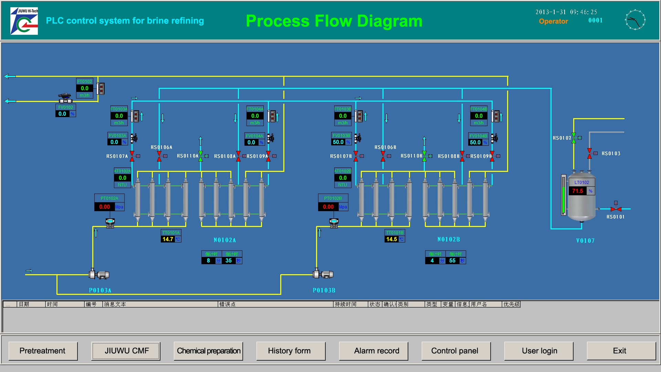

Slide 5
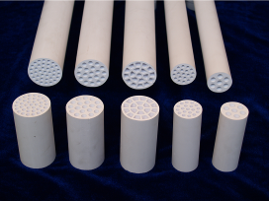
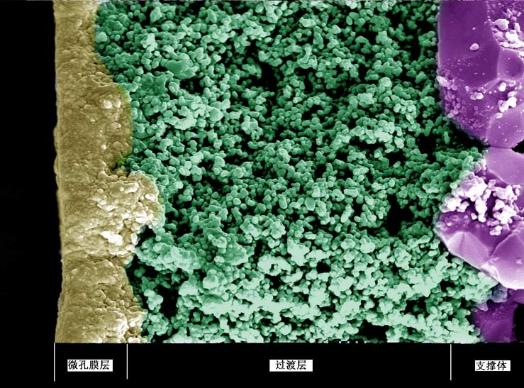
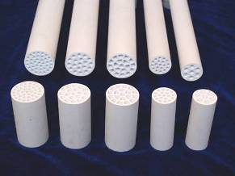
Ceramic membrane Filter - Element> Advantages
Acid/alkaline/oxidation chemicals resistance.
Solvent stability.
High thermal stability and steam disinfected.
Wear ability and excellent strength.
Stable over a wide pH range.
Narrow pore size distribution.
Easy to be cleaned and regenerated.

Slide 6
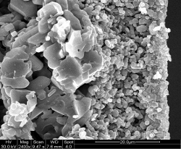
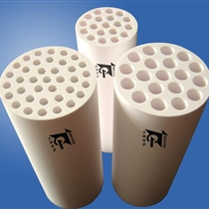
Ceramic membrane Filter – Element’s Material/Structure> Advantages
支撑层
过渡层
分离层
≥99%α-Al2O3
≥99.5%ZrO2

Slide 7
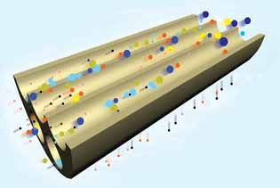
Ceramic membrane Filter – Element’s Filtration Description > Advantages
filtrate
feed
Flow
filtrate
Time

Slide 8
Ceramic membrane Filter> Assembly
Feed Brine
Element
Filtered/Purified Brine
Assembly
Concentrated Brine to Circulation-Pump

Slide 9
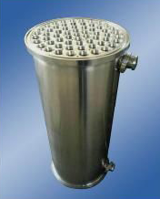
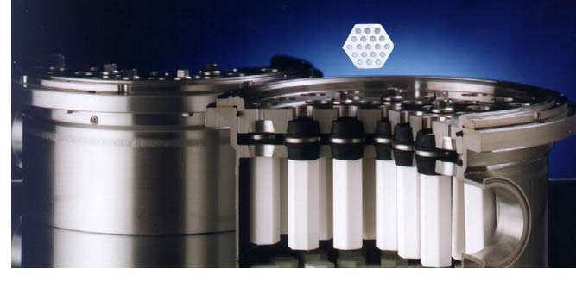
Ceramic membrane Filter> Assembly

Slide 10
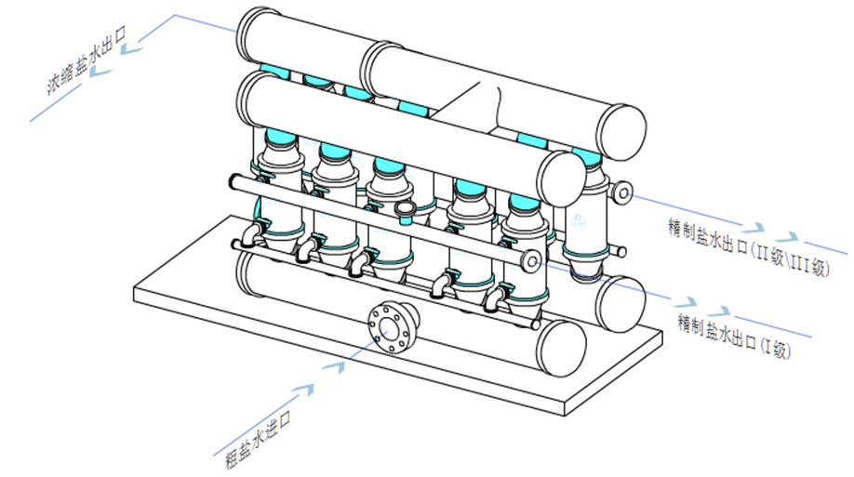
Ceramic membrane Filter> Assembly
Concentrated Brine
Filtered Brine
Filtered Brine
Feed Brine

Slide 11
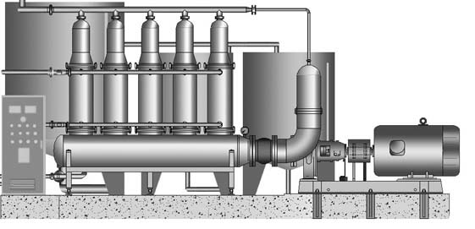
Ceramic membrane> Industry Application>
Ceramic membrane Filter’s Characteristics
Support and transition layer: purity≥99% α-Al2O3
Separation layer: purity≥99.5% ZrO2
Chemically stable, no stripping, no silicon.
Pore size：50nm
Membrane flux：600L/m2.h
Operation pressure：0.25-0.4MPa
Working life:3years

Slide 12
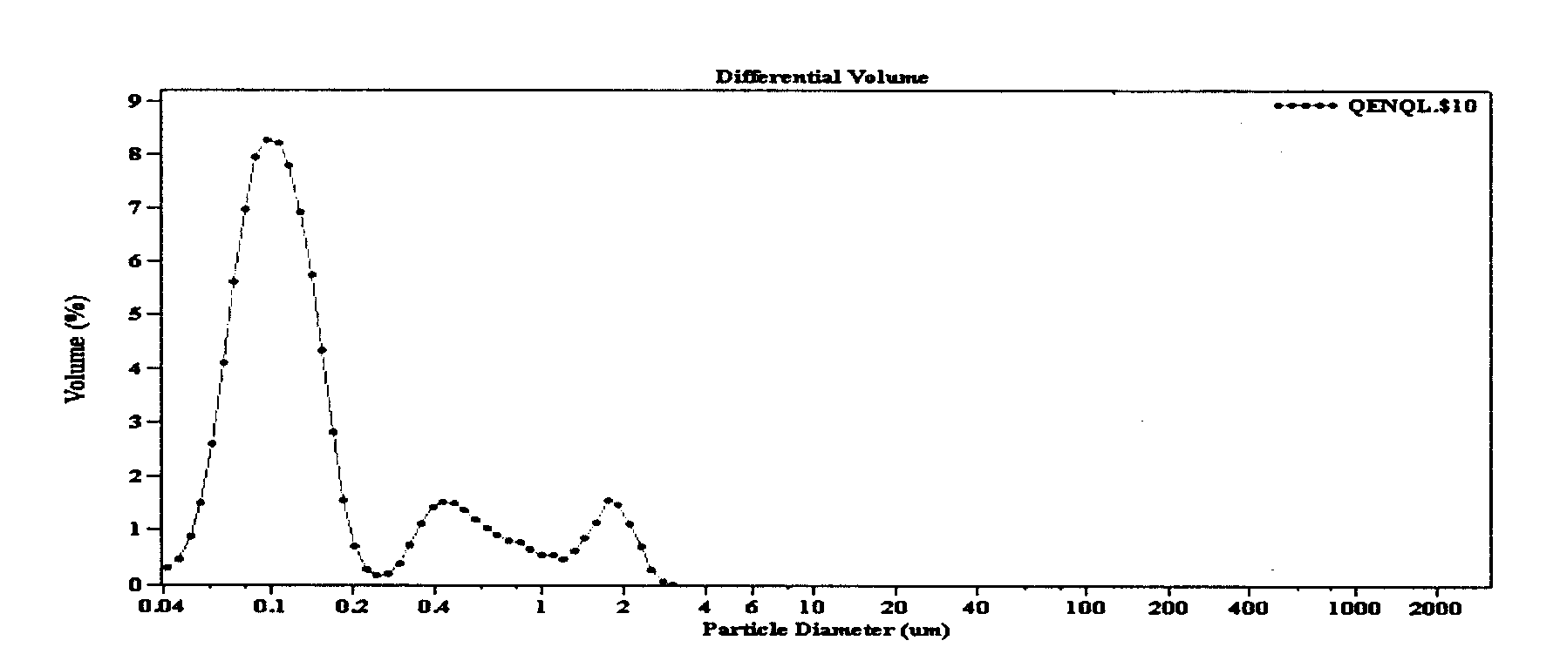
Ceramic membrane Filter> Industry Application>
Refined brine quality
Ceramic membrane pore size ≤ 50nm (mean 40nm)
Filtered brine SS ≤ 0.5ppm
Long-term stability
Without fluctuation

Slide 13
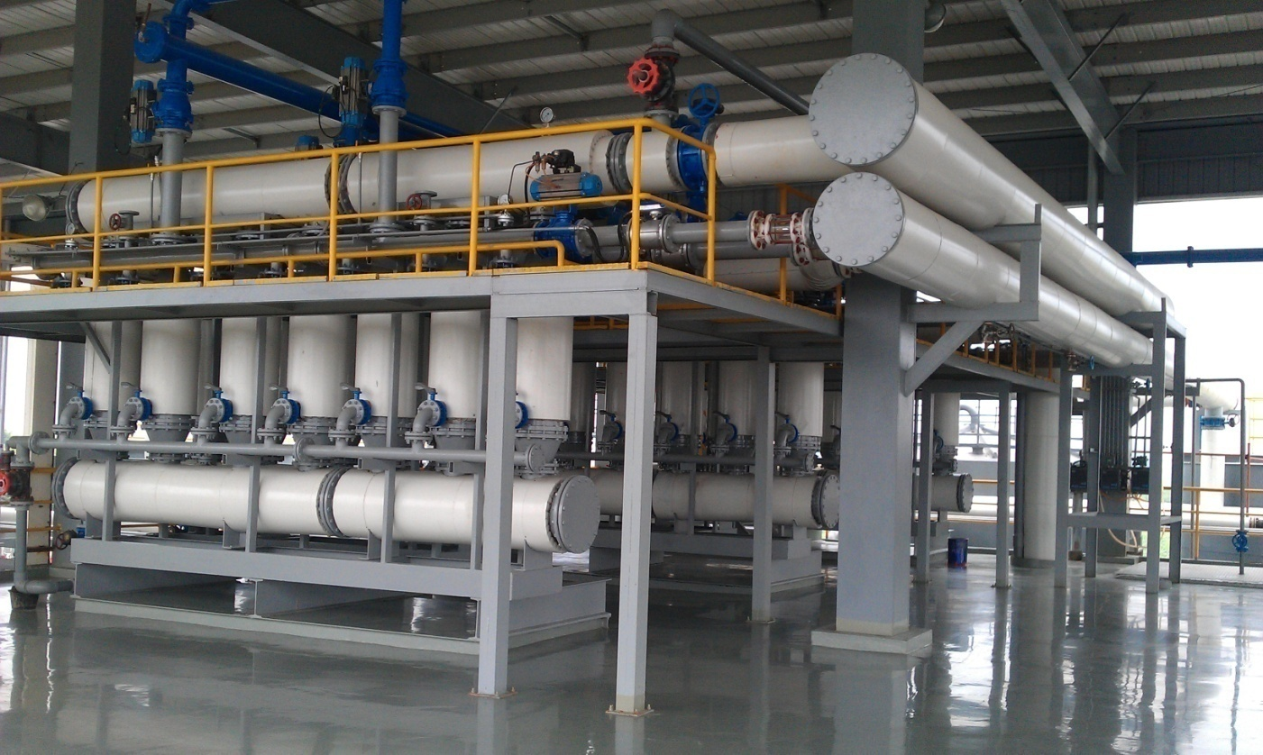

Slide 14
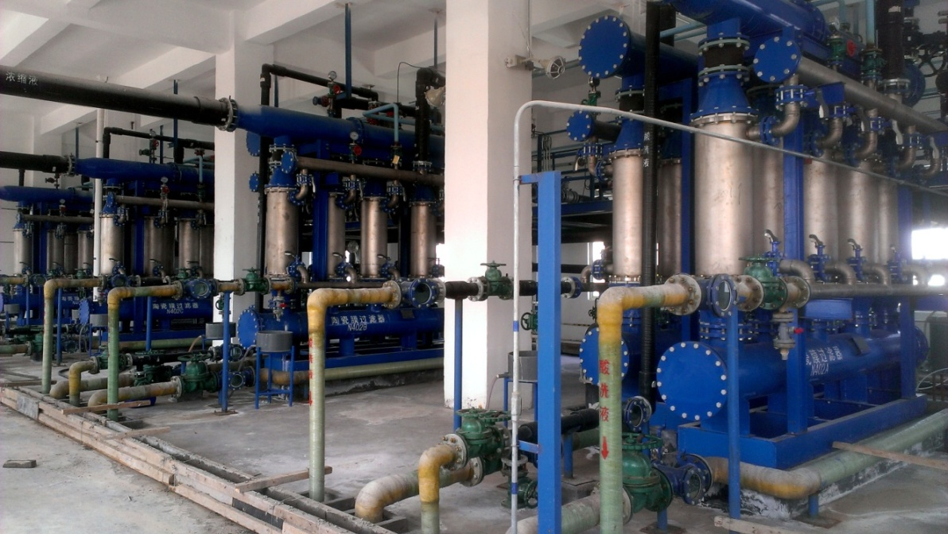
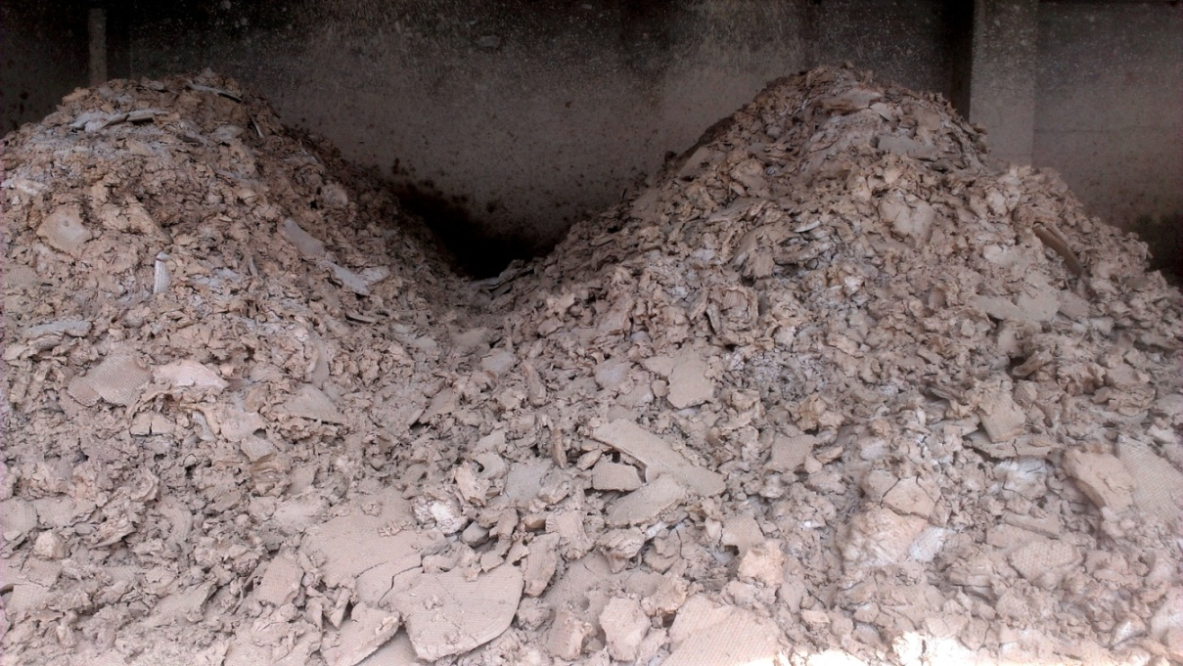
Salt mud

Slide 15
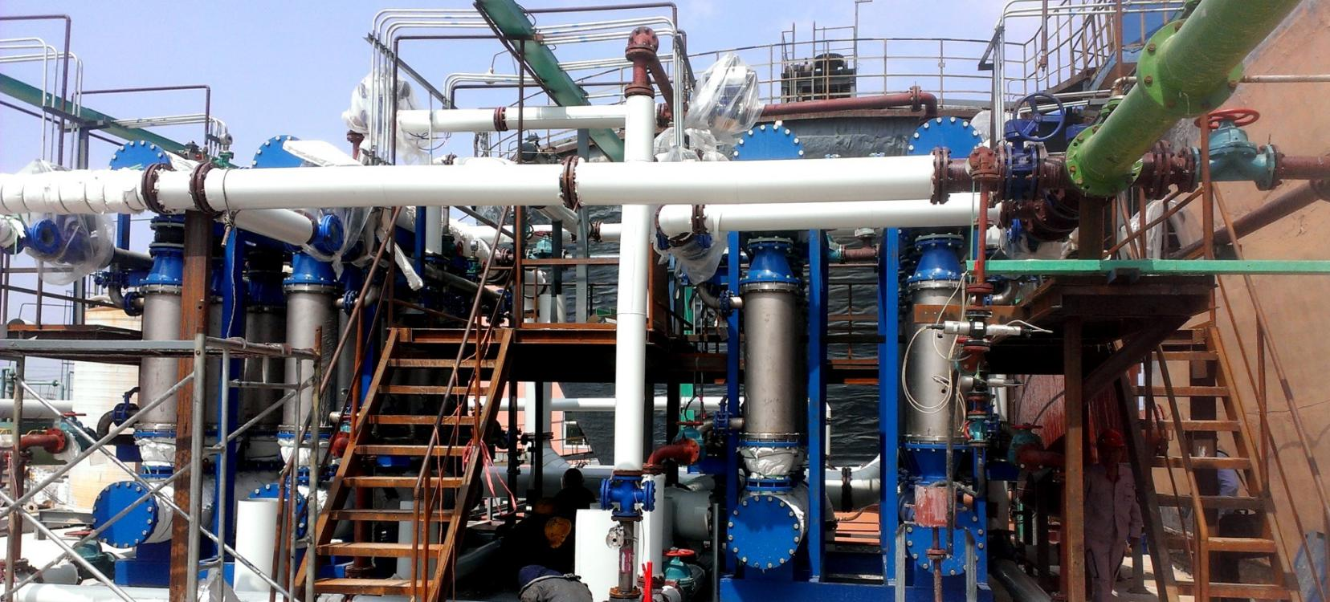
End April 2018

